Slide 1
Digital Portfolio
STUDENT NAME: SIVA.V
REGISTER NO AND NMID: 222404571 / asunm130124j018
DEPARTMENT: BSC.SOFTWARE APPLICATION
COLLEGE: COLLEGE/ UNIVERSITY : A.M JAIN COLLEGE

Slide 2
PROJECT TITLE DIGITAL PORTFOLIO

Slide 3


AGENDA
Problem Statement
Project Overview
End Users
Tools and Technologies
Portfolio design and Layout
Features and Functionality
Results and Screenshots
Conclusion
Github Link
3/21/2024 Annual Review

Slide 4

PROBLEM STATEMENT 1) BUILDING THE STRUCTURE 2) GIVING PERFECT COLOURS 3) INSERTING PICTURES 4) MAKING SCROLLING SMOOTH 5) MAKING IT RESPONSIVE

Slide 5

PROJECT OVERVIEW A Digital Portfolio fully attac hed about my skills in the software world and also it holds my project i have linked my github , linkedin ,Twitter profile

Slide 6

WHO ARE THE END USERS? THE END USER ARE.. The Companies I go for Interview My Online Clients

Slide 7

TOOLS AND TECHNIQUES • HTML css JAVASCRI PT

Slide 8
POTFOLIO DESIGN AND LAYOUT
It has a maginificent Purple blended violet colors and it has my profile photo , My name in the Starting
after scrolling down you can find my projects , and what Skills do i have and lastly you got a information box
to fill up your details and get in touch with me...
- Thank you!!
8

Slide 9
FEATURES AND FUNCTIONALITY Displays My Essential Details Scrolls Smootly it has a Arrow button in the left to scroll up from down

Slide 10
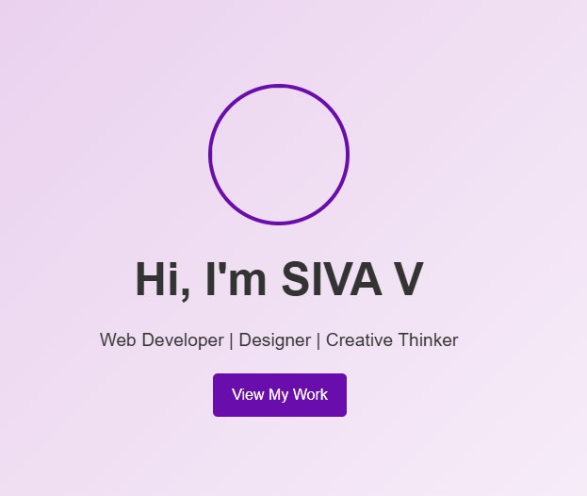
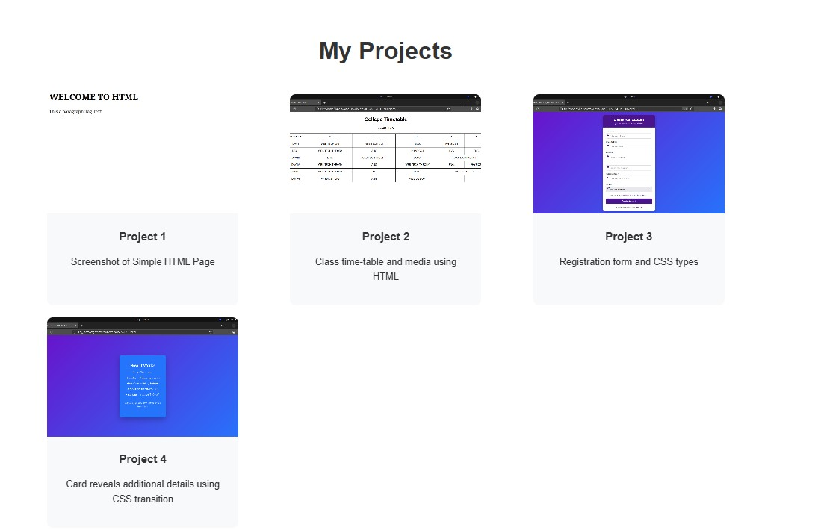

RESULTS AND SCREENSHOTS
3/21/2024 Annual Review
10

Slide 11
CONCLUSION I have created this Portfolio with my Hardwork and consistency
Portfolio link: https://24j018-siva.github.io/TNSTC-FWD
DigitalPortfolio/
Github link : https://github.com/24j018-siva/TNSTC-FWD-DigitalPortfolio.git
11

